Slide 1


Slide 2


Enhance your .NET apps with Azure Communication Services
Chris Palmer
Mary Anne Noskowski

Slide 3
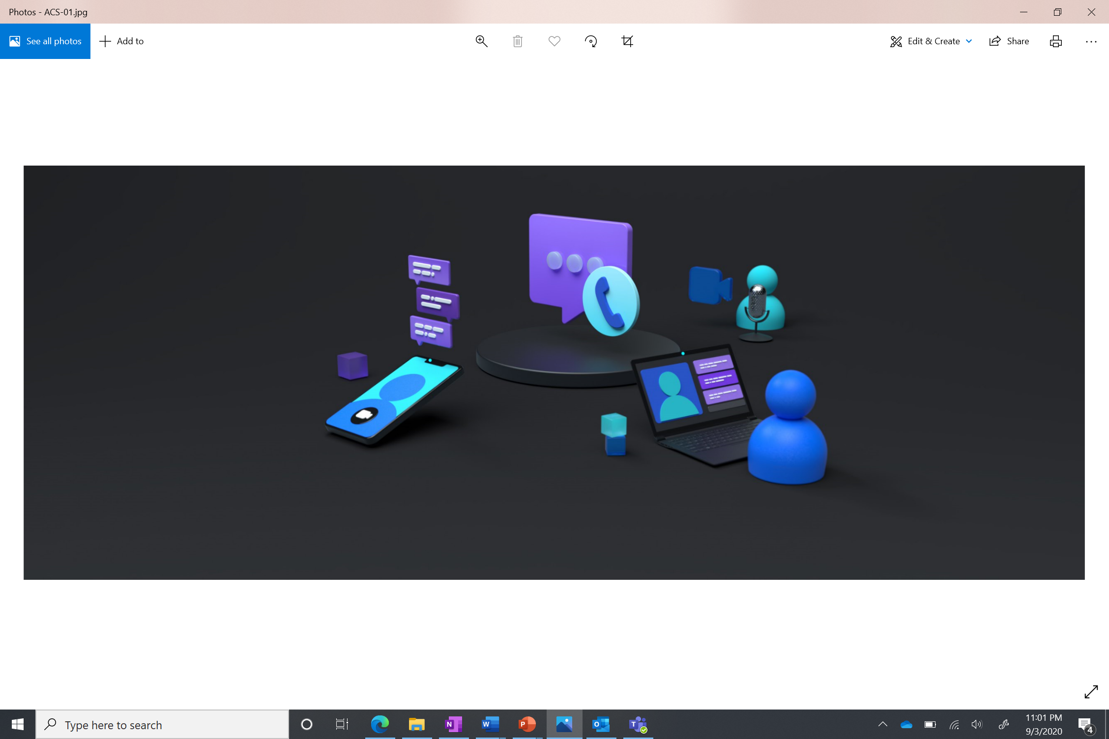
Agenda
Scenarios you can build with Azure Communication Services
Building a .NET Azure Function that drives SMS and telephony notifications

Slide 4


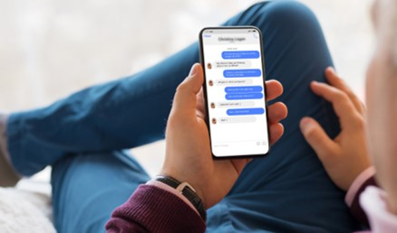
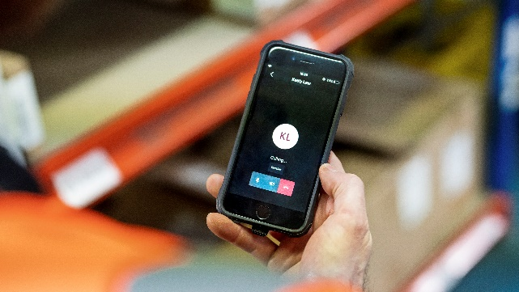
Azure Communication Services
Chat
Deliver rich text communication
Voice & Video Calling
Connect people and services
SMS
Send and receive text messages
Telephony
Acquire phone numbers from Azure or bring your own carrier
Notes:
Let’s go through our core services. Azure Communication Services is offered as a set of SDKs and APIs that enable you add interactive, high quality audio Voice and Video Calling, to make and receive voice and video calls, analyze call metadata, record calls, and even build call trees. You can also integrate Chat capabilities with an easy to use, low maintenance interface to enable One-to-One or Group Chat functionality with all the core functionality you would except from a robust chat experience and more. We also offer a simple setup SMS experience for adding text messaging capabilities to applications for connecting with users that prefer mobile communication. You can use our Telephony services and infrastructure to provision phone numbers for end-to-end communication scenarios.
And lastly, we provide network relay support with TURN protocols for when one or both users are behind a firewall.

Slide 5
Scenarios

Slide 6

Custom Person to Person Communication
Connect end-users with voice, video, and text communication

Slide 7
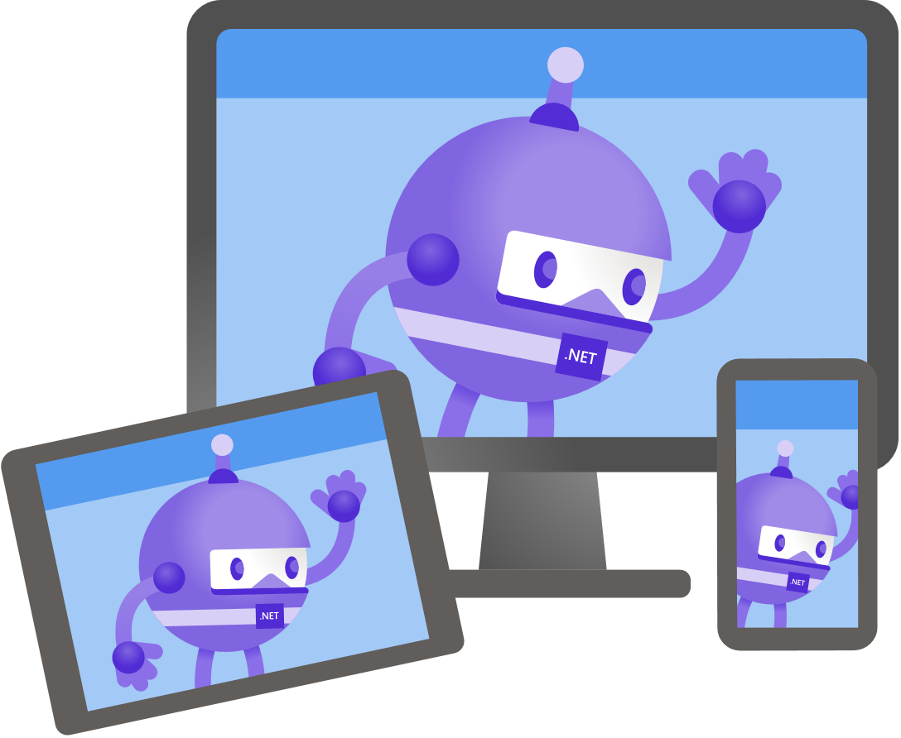
Tailor for your application
Custom Identity
Custom Concepts
Custom UI

Slide 8
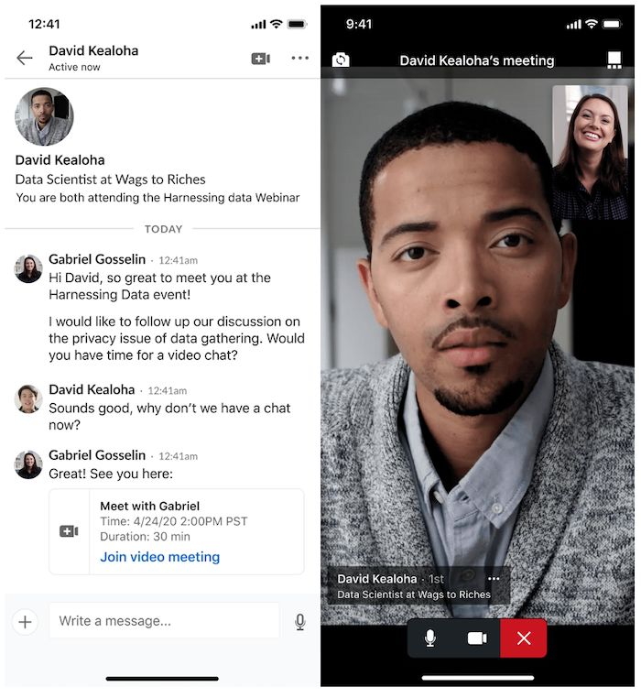
Case Study: LinkedIn

Slide 9

Virtual Visits
Person to person communication but applied to timebound business-to-consumer interaction (B2C)
Consumer
Business

Slide 10


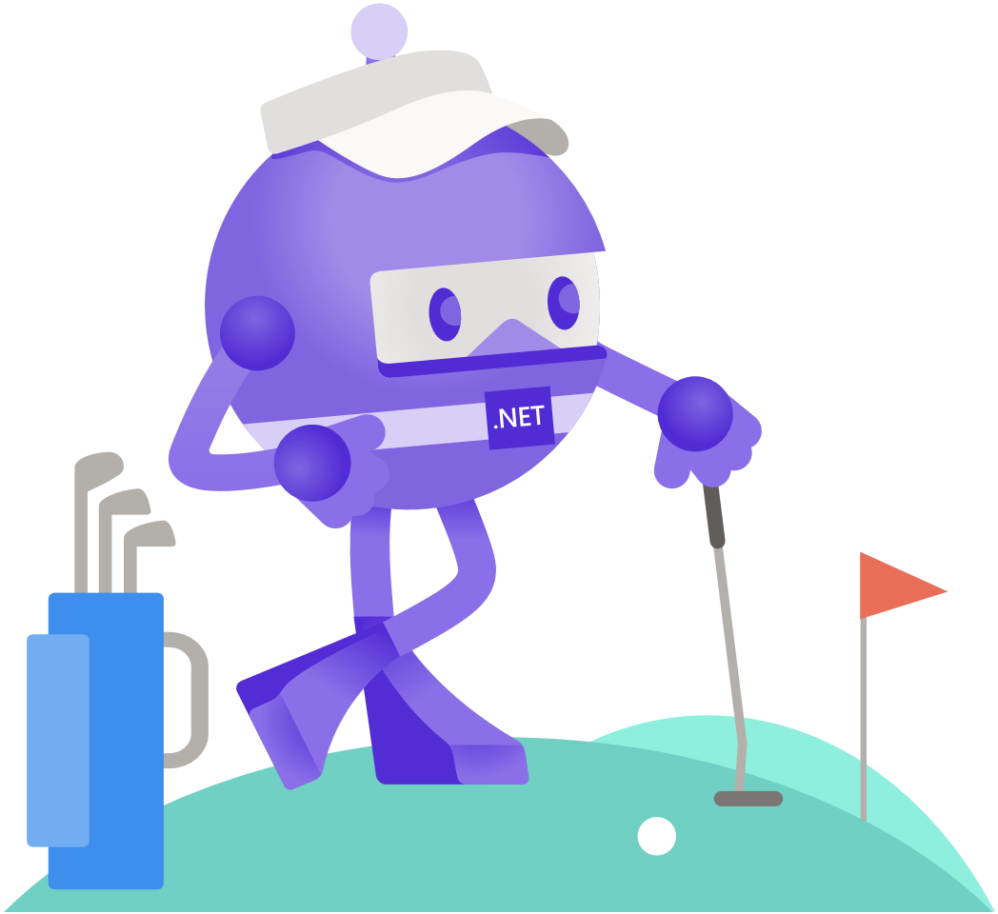
Healthcare
Education
Financial Services

Slide 11
Virtual Visits
Azure and Teams are interoperable
Azure clients can join Teams meetings
Ideal for settings where a business is using Teams internally but wants to connect with external users via a custom app
Consumer
Business

Slide 12

Notifications and Marketing
An organization sends an asynchronous communication through SMS or a phone call

Slide 13



Delivery
Marketing
Public Service

Slide 14
Enabling your scenarios
.NET supported for all sub-systems
 | Azure Resource Manager | Identity | Phone Numbers | SMS | Chat | Calling (Client) | Calling Server (Preview) | Network Traversal (Preview)
.NET SDKs | ✔ | ✔ | ✔ | ✔ | ✔ | ✔ | ✔ | ✔
Custom Communication · Virtual Visits · Notifications and Marketing

Slide 15
Digging into notifications

Slide 16

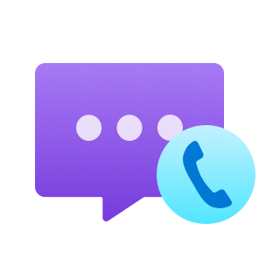


Notifications with Azure Functions
Organization
Single or multi-tenant applications
Automation
Services
Azure Function
Azure
Communication Services
Employees
Notification Recipient

Slide 17
Azure Functions
Serverless computing with less code
Easy to trigger functions from other applications via REST or Power Platform automation
Write functions natively in C# (and virtually any other language)

Slide 18
What does our function do?
Input:
Source Phone Number
Destination Phone Number
Action:
Sends an SMS message to the number
Calls the number and plays an audio file

Slide 19
Demo

Slide 20
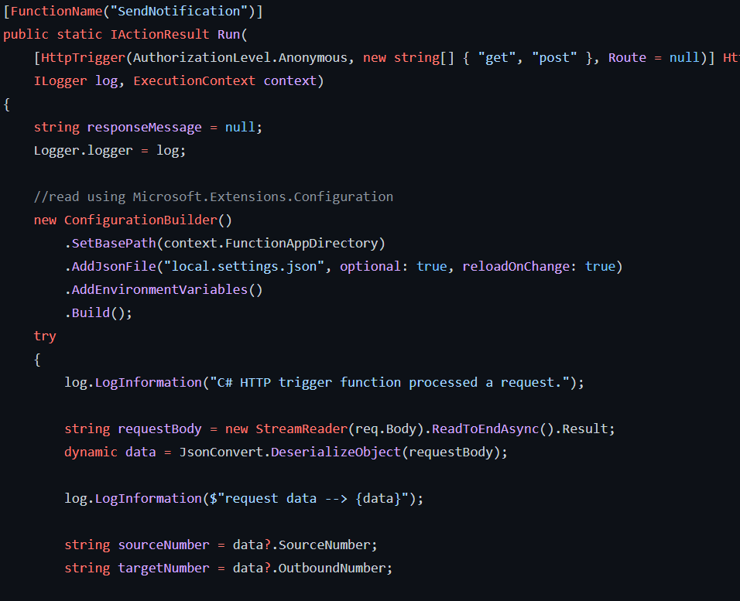
Trigger

Slide 21
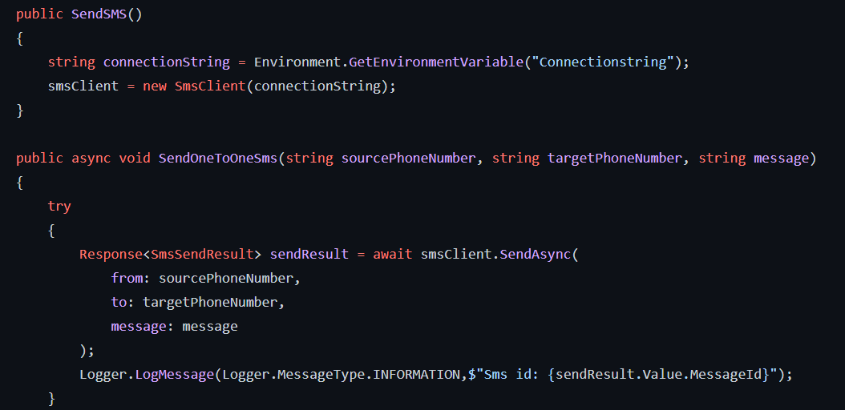
Send SMS

Slide 22
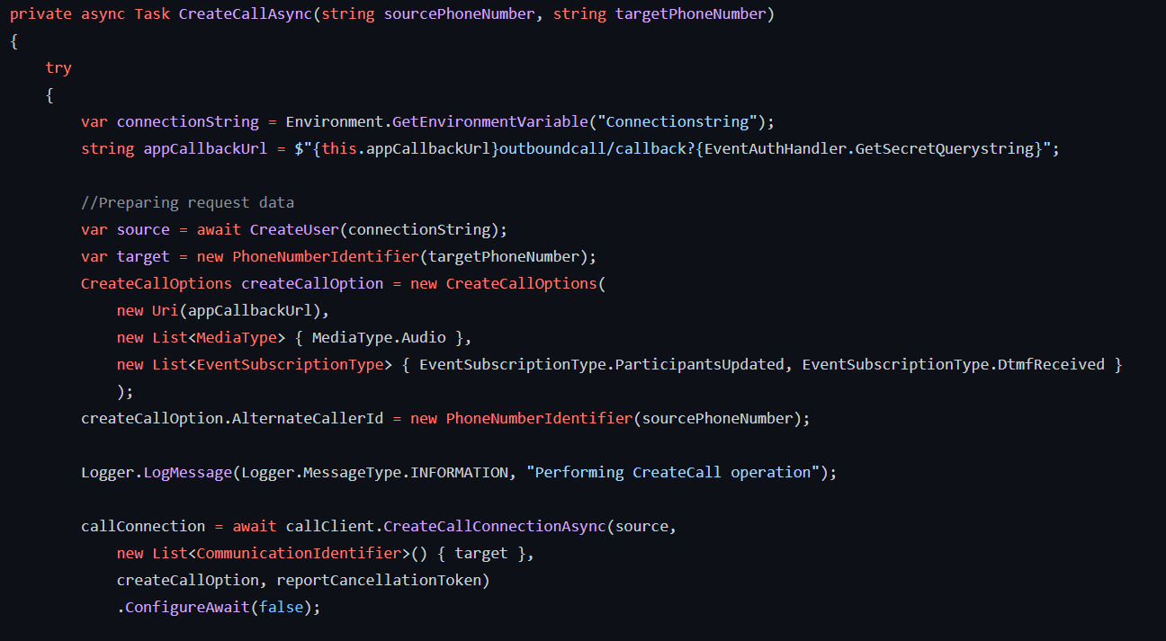
Create Call

Slide 23
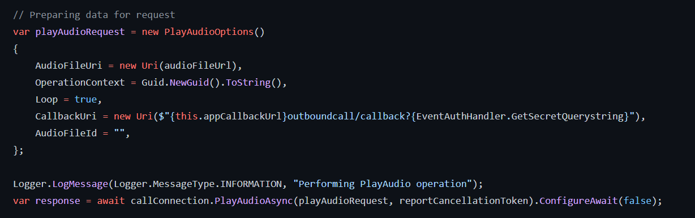
Play Audio

Slide 24
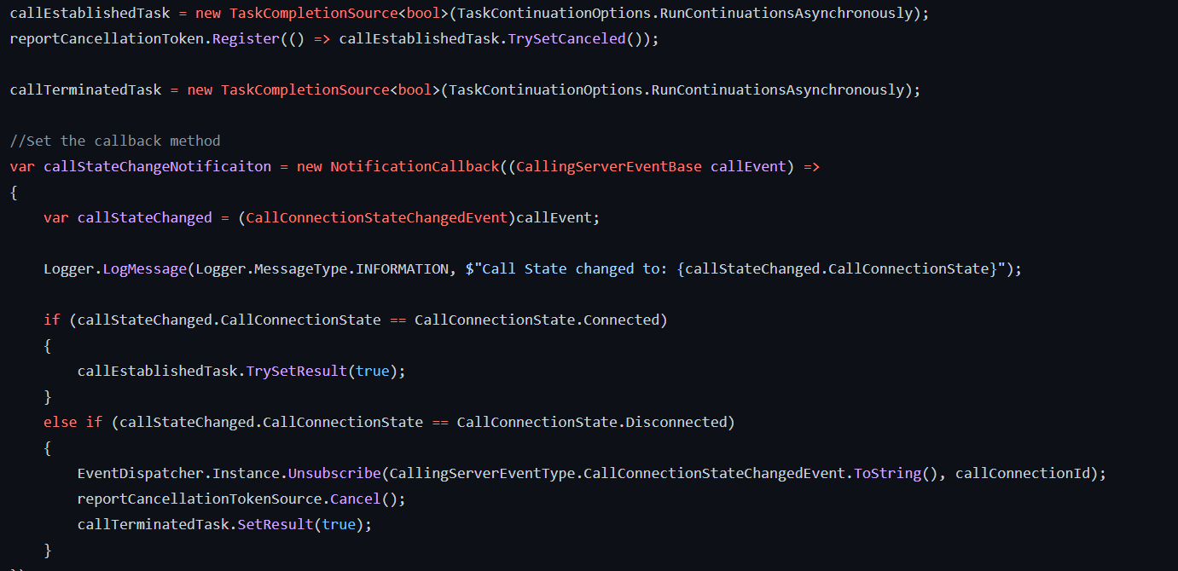
Handle call events (DMTF tones, disconnect)

Slide 25
Get started with Azure Communication Services
Find this exact sample at GitHub:
https://aka.ms/acs-net-2021
Find other samples and learn more at:
http://aka.ms/acs

Slide 26

Thanks for joining!

Slide 27
Stand-by questions
PSTN Geo-expansion
MMS and Group Text
Xamarin – sorry no
Email - stay tuned

Slide 28






Slide 29






Slide 30
Short Codes – public preview
Send and receive messages directly to/from customers
Purchase through SDK or Azure Portal
Available in the US
Learn more at aka.ms/acs-shortcodes

Slide 31







Slide 32





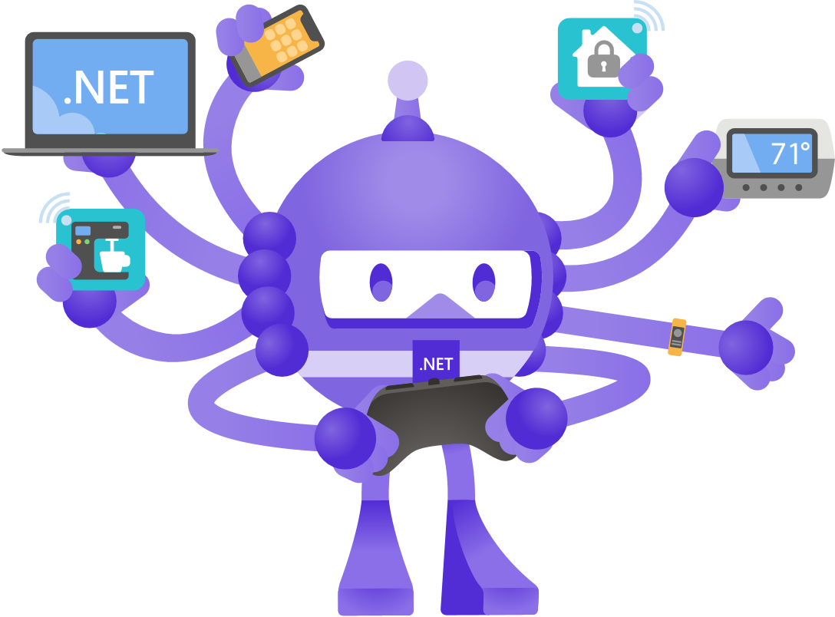


Slide 33





Slide 34


Slide 35


Slide 36


Slide 37


Slide 38


